Slide 1

Contraceptive Choices
8.ICR.3.2 Evaluate methods of FDA-approved contraceptives in terms of their safety and their effectiveness in preventing unintended pregnancy.
9.ICR.3.4 Exemplify decision-making skills and problem solving regarding safe and effective use of methods to prevent unintended pregnancy.
Notes:
Ask students to read the items in the Wordle. Ask, Are these terms familiar to you? If not, they will be. Everyone needs to know about the information and products available for now and in the future to prevent an unintended pregnancy.

Slide 2

Objectives
Identify considerations when selecting contraceptive methods
List commonly used contraceptive methods, including the LARC methods
Explain how each contraceptive works
Evaluate contraceptive options
Notes:
Tell students that at the end of the PowerPoint, they should be able to:
Identify considerations when selecting contraceptive methods
List commonly used contraceptive methods, including the LARC methods
Explain how each contraceptive works
Evaluate contraceptive options

Slide 3
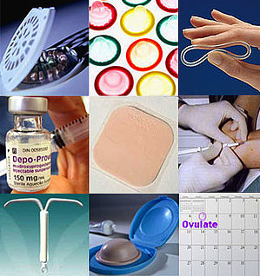
What is Contraception?
Chemical, device, or action used to prevent pregnancy
Works in a variety of ways
Except for condoms, is NOT a method to reduce risk for STDs!
Notes:
In the sixth grade, you should have learned about conception, the joining of the egg with a sperm to create a new life. CONTRA-ception is a method of preventing a pregnancy from occurring from the act of sexual intercourse. It may be a chemical, a device, or an action taken. Keep in mind that methods of contraception (with the exception of condoms) do not also prevent the risk of sexually transmitted diseases.

Slide 4

Which Contraceptive Method is Right?
Reflect :
Individual health risks
Risks for STDs
Convenience and comfort level
Type of relationship
Ease of use and cost
Religious or other philosophical beliefs
Can be used by either male or female
Implications of unplanned pregnancy
Notes:
Deciding on a method of birth control depends on many factors. Reflecting on this list is helpful.

Slide 5


Considerations
Effectiveness
Convenience
Cost
Reversibility
Risks (safety)
STD protection
Notes:
A health care provider can help with these considerations.

Slide 6
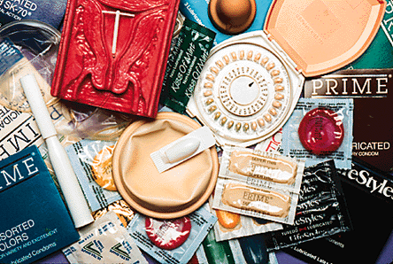
Types of Commonly Used Methods
Abstinence
Barrier Methods
Hormonal Methods
Chemical
Other
Notes:
Birth control can be categorized into these types.

Slide 7

Definition of Abstinence
Voluntarily refraining from intimate sexual behavior that could lead to unintended pregnancy and disease.
Notes:
Abstinence is defined as voluntarily refraining from intimate sexual behavior that could lead to unintended pregnancy and disease. It is not the same as virginity. A person who is sexually active can decide to become abstinent again. Abstinence is a positive choice for young people.
Please notice the word, voluntarily. We need to acknowledge that some young people did not have a choice about abstinence. They may have been forced or manipulated to have sex when they did not wish to. They should seek assistance from a trusted adult to get the care they need, physically, emotionally, and legally.

Slide 8

Abstinence
Abstaining from sexual intercourse for a chosen period of time.
Considerations:
  Effectiveness: 100%
  Convenience: 100%
  Reversibility: immediate
  Risks: none
  STD protection: perfect (if used consistently)
It’s the one method that everyone uses at some point in their lives!!
Notes:
In this slide, we see some of the advantages of choosing to be abstinent. Yet abstinence is similar to methods of birth control in that it must be practices consistently and correctly. A teen cannot expect to avoid the risks associated with sexual behavior if they are only abstinent some of the time.

Slide 9
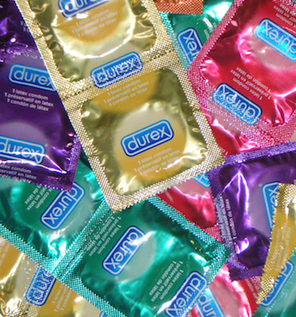
Barrier Methods
Male and female condoms
Work by physically blocking sperm from reaching egg
Considerations:
  Effectiveness: 79 – 95% (female condom is lower)
  Convenience: easily accessible, interrupts sex
  Cost: low or free
  Reversibility: immediate
  Risks: latex allergy (opt for polyurethane)
  STD protection: high (best of all the methods except abstinence)
Notes:
Barrier methods include the male and female condom. Please read this information. Condoms are easily accessible and afford the extra benefit of protection against sexually transmitted disease and infections. Condoms are highly effective against the transmission of HIV and other STDs as well as preventing pregnancy.

Slide 10
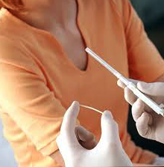
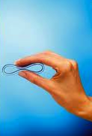

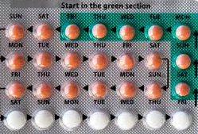
Hormonal Methods
Considerations
  Effectiveness: 92 – 99.95%
  Convenience: requires a prescription and usually an exam
  Cost: depends on method
  Reversibility: quick return to normal fertility (except injectables)
  Risks: mild (breast tenderness) to severe (increased risk of blood clots)
  STD protection: none!
Notes:
The MOST effective forms of birth control are the hormonal methods. Read the information on the slide and notice the high level of effectiveness.

Slide 11

Effectiveness
Most
Vaginal contraceptive ring
Injectable contraceptives
Double Dutch
Contraceptive skin patch
Oral contraceptives
Female condom
E.C.
Male condom
Vaginal spermicides
Intra Uterine Device
Contraceptive
implants
Least
Withdrawal
Notes:
By the end of the lesson, you will be able to rank order these methods based on effectiveness.

Slide 12
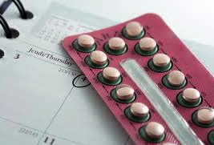
Contraceptive
Effectiveness
Use Effectiveness: How well a birth control method works in ”typical use”, taking into consideration human error and other non-ideal factors.
Theoretical Effectiveness: How well a birth control method works when it is used correctly and when all other conditions are ideal: “perfect use”.
Notes:
Doctors and scientists rate birth control effectiveness in two ways: “typical use” and “perfect use”. [Allow time for students to read the slide.] Consider the teen boy who is nervous about his first sexual experience and forgets to put on a condom even though he planned ahead and has one with him. Or the teen girl who takes the Pill, but not at the same time each day. Or the young woman who fails to go back for a shot after three months. These are examples of human error that reduce the effectiveness of the methods.

Slide 13

What’s Recommended?
For sexually active couples who do not wish to get pregnant: LARC:
  IUD
  Implantable rod
Notes:
To prevent human error which compromises contraceptive effectiveness, the LARC methods are recommended for young women who may eventually want to have children, but want to be as certain as possible that they do not get pregnant until later. LARC stands for Long Acting Reversible Contraception. Because the IUD (intrauterine device) or the implantable rod is inside the body, there is no opportunity for human error.

Slide 14

LARC:
Eliminates Human Error
Long acting reversible contraceptives
Include:
  Implant (Nexplanon)
  IntraUterine Device (IUD: Skyla, Mirena, or ParaGard)
Highly effective and considered BEST choices for reducing risk for teen pregnancy.
Paired with a condom, they are even more effective (Double Dutch!).
Notes:
These are the products available today that are LARC methods. [Allow time to read the slide.]

Slide 15
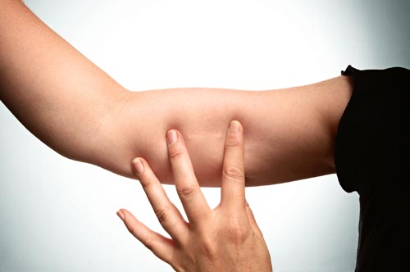
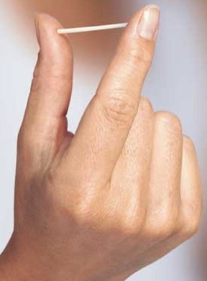
Implants
Placed under skin by professional to deliver small, steady doses of progestin
Nexplanon: 1 rod; effective for three years
Highest effectiveness rate of hormonal methods (removes human error)
Notes:
Nexplanon is a subdermal implant, a hormonal method, which has the highest effectiveness rate for preventing pregnancy.

Slide 16
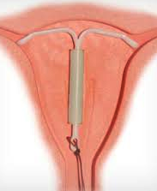
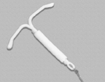
IUD: Mirena
Small, "T-shaped" device placed in uterus.
Releases a small amount of progestin.
Safe, effective, and long-lasting (5 years).
Only available by health care provider.
Notes:
Slides #17, 18, 19 – These products are the types of intrauterine devices available: Mirena, Skyla, and Paragard. Skyla is more often prescribed for young women who have not yet had a child because it is smaller than the other two. As I move through the slides, notice the length of time for which they provide protection. An IUD must be placed inside the woman’s body by a health care provider.

Slide 17
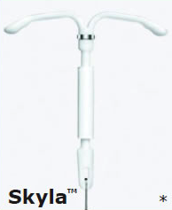
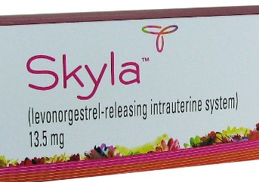
IUD: Skyla
Same hormone as in Mirena, just less
Works for 3 years
Smaller device
Only available by health care provider

Slide 18
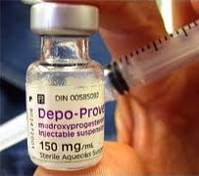
Injectables
Depo-Provera
  Long-acting progestins injected every 12 weeks
  Works like implants - side effects the same
Decrease in bone density. (Woman should increase physical activity and calcium intake.)
Greater likelihood of weight gain.
Slower return to normal fertility
(12-18 months after disuse).
Highly effective.
Notes:
Depo-Provera is an injectable hormonal method of birth control, which is also highly effective. The woman needs to go back to her provider every 12 weeks.

Slide 19
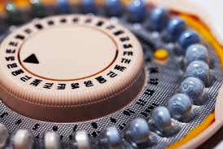
Oral Contraceptives, a.k.a. “the Pill”
Mimic hormonal activity of progesterone and estrogen
  prevents ovulation
  thickens cervical mucus
  changes lining of the uterus
Not recommended for females who:
  smoke
  have blood clots, heart disease, stroke, cancer, liver problems, high blood pressure, and migraines
Should be taken at the same time every day
Also available:
              Seasonale/Seasonique
                Take pills continuously for 3 months
                Menstruation occurs 4 times per year
              Lybrel - 365 day pill
Notes:
Many young women ask to be on the pill without realizing there are other options. The pill is also highly effective and for decades has helped control fertility for women in the United States. [Allow time to read slide.]

Slide 20

Nuvaring
2.1 inch ring placed in vagina for 3 weeks and removed for one week
Releases progestin and estrogen directly into blood system through the vaginal wall
Notes:
Another hormonal method is the Nuvaring. A woman needs a prescription and then places the ring into her vagina for a three-week period. She removes the ring for one week, during which time she will have her period. She inserts a new ring one week later, for another three-week period. The Nuvaring is highly effective, but must be used correctly and consistently. If it is placed correctly, neither she nor her partner will feel it.

Slide 21
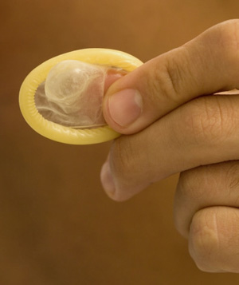
Male Condom
Best Practices:
  Store in a cool, dry place
  Check expiration date
  Use a new condom with every act of intercourse
  Leave a receptacle in the tip
  Use before any sexual contact begins
  Remove without leaking any fluid
Notes:
Condoms are highly effective if used correctly. This slide lists the steps of correct use. No intimate contact (that includes body fluid touching mucous membrane tissue) should occur before the condom is in place. Care needs to be taken for the condom to be removed away from the partner’s genitals.

Slide 22
Condoms
What is is? Barrier Method
How does it work? Work by physically blocking sperm from reaching egg
Condoms: very effective against several STDs; less effective (but still of value) against STDs transmitted by “skin to skin” contact
Must be used correctly and consistently every time!
Risks?

Slide 23
Condoms
Widely available, low or no cost
Local health department or family planning clinic
Drug stores and chain stores
No age restriction
Both males and females can get condoms
Get them before they are needed

Slide 24
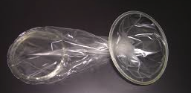
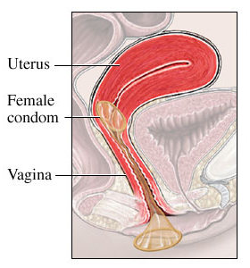
Female Condom
Can be inserted up to 8 hours before intercourse
Provides protection against STDs
Not as effective as male condom
Made of polyurethane
Notes:
Another barrier method is the female condom. It provides the female with some control over the prevention of sexually transmitted infections. It can be purchased over the counter and must be in place before sexual intercourse. It requires cooperation by the partner so that penetration of the vagina is inside the condom. It is somewhat less effective than the male condom, but still effective.

Slide 25
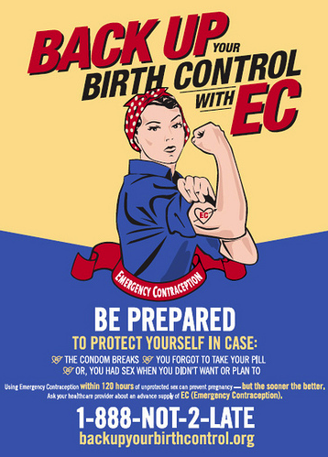
Emergency Contraception
Plan B, Plan B One Step, Ella
Within 72-120 hours of unprotected sex
The “sooner the better”
7 of 8 women will NOT get pregnant after using E.C.
Not recommended as regular contraception
Will NOT cause an abortion
Notes:
Please read the slide about emergency contraception. If a couple has engaged in unprotected sex or if the female has been manipulated into or forced to have sex, there is an option that can reduce the chances she will get pregnant. It is called Emergency Contraception. Some people think it is a form of abortion . . . it is NOT. If she is already pregnant, it will not affect the pregnancy. Depending on the brand, it needs to be used within 72 to 120 hours of unprotected sex. The sooner it is used after unprotected sex, the more likely the method is to work.

Slide 26
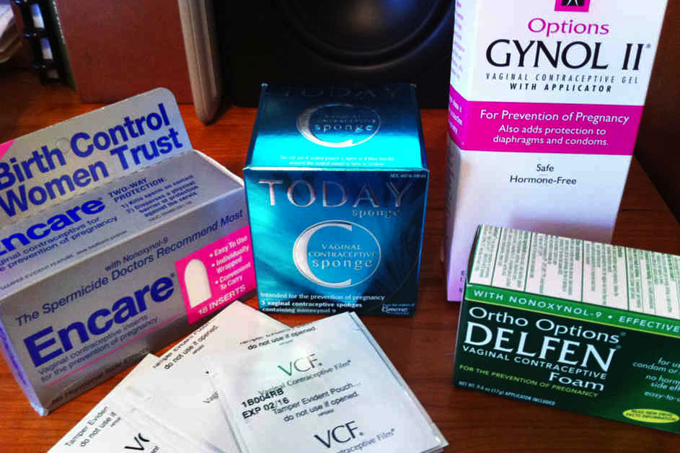
Other (Less Effective) Methods
Vaginal spermicides
Withdrawal
Notes:
There are methods that are less effective, such a spermicides and withdrawal.

Slide 27
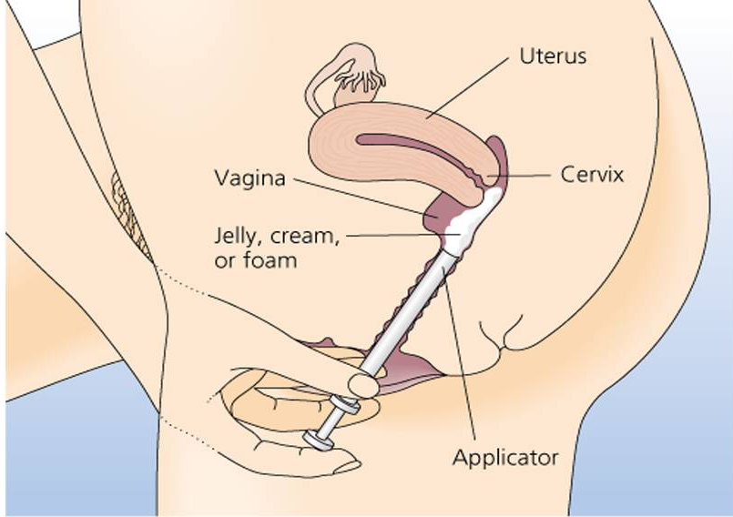
Vaginal Spermicides
Work by killing sperm on contact
Foams, jellies, creams: used 30 minutes in advance
  Reapply after 1 hour
Suppositories, and films: wait 15 minutes to dissolve
  Effective for 1 hour
Considerations
  Effectiveness: 71 - 82%
  Convenience: over-the-counter
  Reversibility: @ 1 hour
  Risks: possible allergic reaction
  STD protection: none!
Not a “stand alone” method, for use with a male or
female condom
Notes:
Spermicides are chemicals that kill sperm. They come in several forms (foams, jellies, creams, and suppositories) and can be purchased over the counter. It is recommended they be sued with a barrier method such as a male or female condom. Timing is everything: one must read the directions!

Slide 28
Withdrawal
Removing the penis from the vagina prior to ejaculation
Concerns:
  Pre-ejaculatory fluid which contains sperm and may contain pathogens causing STDs
  Relies on control and motivation of the male
Considerations
  Effectiveness: @ 73%
  Convenience: free
  Reversibility: immediate
  Risks: low effectiveness rate
  STD protection: none!
Poor Choice!
Notes:
Withdrawal relies on the male “pulling out” before he ejaculates. There are two reasons this method is not particularly effective: one is that there is pre-ejaculatory fluid which can contain sperm and the organisms that can cause an STD; the second has to do with the male’s ability to practice self-control. Withdrawal is thought to be more effective than no method at all.

Slide 29
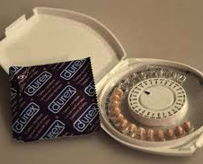
Always choose…
Double Dutch
When intercourse takes place, the male is using a condom and the female is using a reliable contraceptive, such as a hormonal method
Enhances the effectiveness to almost 100%
Notes:
It is suggested that the best method is TWO methods: a highly effective hormonal method used by the female and a male condom. The advantages are that both parties take responsibility, and that there is protection from STDs as well as pregnancy.

Slide 30

A Male’s Role
Initiate support and communication
Buy and Use Condoms when appropriate
Help pay contraceptive cost
Be available for shared responsibility for consequences of contraceptive failure
Notes:
On this slide we see ways that boys and men can be part of the process. {Allow time for slide to be read.]

Slide 31
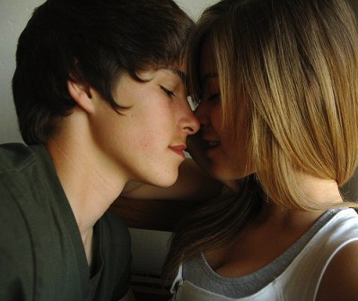
Communication
Rehearse communication with a friend
Choose a good time to discuss methods
Share what you know and how you feel
Listen
Pick a method both parties are comfortable with and will use consistently and correctly
Notes:
Couples who are planning to be sexually active can demonstrate they are responsible and mature by using effective communication. Here are some strategies to follow.

Slide 32
High Risk, Low Risk, No Risk
Read the following cases and in each box, write the person’s risk category for pregnancy and for sexually transmitted diseases.
HI: High Risk- behaviors that are very likely to result in the possibility of pregnancy or disease
LO: Low Risk- behaviors that are somewhat likely to result in the possibility of pregnancy or disease
NO: No Risk- behaviors that are not at all likely to result in the possibility of pregnancy or disease

Slide 33

What 50 Years of Research Tells Us about a Teen’s Mom Future
A teenage girl who gets pregnant has written 90% of her life’s script.

Slide 34
A teenage girl who gets pregnant has written 90% of her life’s script
How does this make you feel and why is the statement true?
Is it different for teen fathers?

Slide 35
Too Young
www.thenationalcampaign.org/tooyoung

Slide 36
Two skills that can help a teen decrease the chances of being a parent before he or she is ready are decision making and goal setting

Slide 37
Decision Making for Health
examines barriers to healthy decision making;
determines value of applying thoughtful decision making;
justifies when individual or collaborative decision making is appropriate;

Slide 38
Decision Making for Health
(continued)
generates alternatives;
predicts potential short-term and long-term impact of alternatives; and
defends healthy choices and evaluates effectiveness of health-related decisions.

Slide 39
Goal-Setting for Health
assesses personal health practices and health status;
develops a plan to attain a personal health goal;
implements strategies, including self-monitoring, to achieve the goal; and
formulates effective long-term personal health plan.

Slide 40
5 Step Decision-Making Model
Describe the situation that requires a decision
Brainstorm options. Consider recourses required
Evaluate the consequences of each decision
Choose the best decision and create a plan of action
Act on your decision and evaluate the results

Slide 41
Partner work
Work with a partner
You will be think about how to apply a decision making plan to a young person’s life
I will give you a brief description of a scenario
You will use the decision making model to brainstorm a decision making process to determine a possible outcome.

Slide 42
Letter to a Teen
Write a Letter (to a Teen)
Assignment: Write a letter to your teen about considering becoming sexually active.
Educate him or her about the importance of goal setting and decision making and how each affects the other.
Tell him/her about abstinence and contraceptive choices that can reduce his/her chances of becoming a teen parent.
Include some of the facts about teen pregnancy from the “Too Young” handout.

