Slide 1
Unit 1 Test Review

Slide 2
3 Stages of Stress
Alarm Stage: Flight or Fight -Body realizes it is stressed- triggers physical reactions -inc. blood pressure, inc. heart rate, inc. respiratory rate
Resistance Stage: acts as an equalizer -brings body functions back to normal
Exhaustion Stage: Body returns to normal if stress is removed. -Body returns to alarm stage if stress continues -results in stress-related diseases: skin disorders, cardiovascular disorders

Slide 3
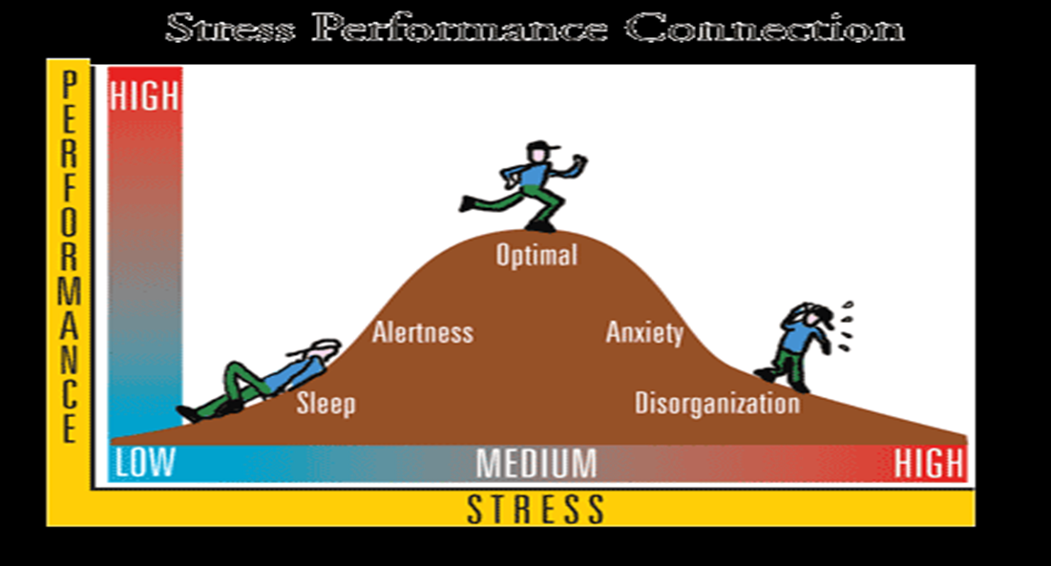
Healthy Amounts of Stress
Stress acts as a motivator
Too much stress can lead to mental illness such as anxiety or depression

Slide 4
Stressors in Modern World vs. before Modern Civilization
Before Modern Civilization -need for food -need for water -need for shelter -successfully hunting and gathering -surviving in constant threats in life
Modern World -unemployment -financial difficulties -traffic -social frustrations -deadlines -homework -bills

Slide 5
Stress Management Today vs. Ancient Civilizations
Today -eat -sleep -hurt self -prayer, meditation -medications -listening to music -smoking, drinking, drugs
Ancient Civilizations -worship -hieroglyphics -constellations -finding meaning in life

Slide 6
What is anxiety?
An uneasy feeling or the act of worrying about what may happen
What causes anxiety?
What are symptoms of anxiety?
What are effects of anxiety?

Slide 7
Depression
Prolonged feeling of helplessness, hopelessness, and sadness
Is anxiety normal?

Slide 8
Tools to Reduce Stress
Be able to know examples of tools to reduce stress

Slide 9
Signs of excessive anxiety
Having feelings of fear or worry most of the time
Being easily distracted and difficulty concentrating
Have muscle tension and unable to relax
Changes in appetite
Difficulty falling asleep
Experience physical problems

Slide 10
Dealing with stress
Taking care of our bodies -eating healthy -getting enough sleep -exercising
Asking for help when you need it
Determine if stressor is within your control
Medication: after a thorough physical and diagnostic evaluation, medication is often used in the treatment of depression and other mental disorders

Slide 11
Sources of Help for Mental and Emotional Disorders
Parent or family member
Mental Health professional
School nurse
Priest, minister, rabbi or other clergy member
Teacher or school counselor
Hot line

Slide 12
Mental Disorders
Know definitions, symptoms and treatment methods of the following
General Anxiety Disorder
Social Phobia
Obsessive-Compulsive Disorder
Post Traumatic Stress Disorder
Panic Disorder

Slide 13
Barriers
What is a barrier
Barriers to seeking help for a mental disorder

