Slide 1
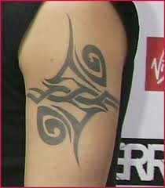
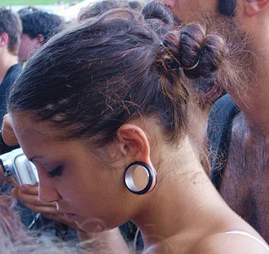
Lesson 4: Tattooing and Body Piercing
9.PCH.2 Evaluate health information and products
9.PCH.2.1 Critique the potential health and social consequences of body art(tattooing and body piercing)

Slide 2
Warm Up (Page 4:PCH Notes) Title: Tattooing and Body Piercing
What are some current fashion trends that involve minor alternations to a part of the body?
What trends are students attracted to?
What trends do they think improve their appearance?
Do celebrities, including sport starts, sometime influence our decisions?
What would be some disadvantages to having tattoos as an adult?
What are some disadvantages to having multiple body piercings, more than one in each ear, as you become an adult?

Slide 3
Tattooing and Body Piercing: Thinking Smart About Body Art Video
What are some health consequences that an individual needs to consider when he/she considers getting a tattoo?
What are some health consequences that an individual needs to consider when he/she considers getting multiple piercings?
What are some social consequences that an individual needs to consider when he/she considers getting a tattoo or body piercings?
How important are these social consequences to you?
Will that change as you get older?

Slide 4
Think Smart About Body Art Article
What factors need to be considered when selecting this form of body art?
What precautions and information should an individual find out before making the decision to get a tattoo or body piercing?
What is involved in getting a tattoo or having a body piercing done? Describe how each is done.
What are the benefits of engaging in this activity?
What are the short term and long term health risks?
Why do people engage in these activities? What is the attraction?

Slide 5
Want a tattoo? Think First
Infections or blood-borne diseases such as Hepatitis B or C, Tetanus, and HIV/AIDS from equipment and needles that were not sterile
Allergic reactions to tattoo pigments
MRI complications
Unwanted scar tissue may form when getting or removing a tattoo
Keloids-Red, raised scarring caused by excessive tissue repair
Granulomas – These small knots or bumps may form around material that the body perceives as foreign, such as particles of tattoo pigment
Dissatisfaction –Tattoo removal is difficult and painful
People with certain kinds of tattoos are not eligible for enlistment in the military

Slide 6
Possible Health Results of Body Piercing
Blood-borne disease such as Hepatitis, Tetanus, and HIV/AIDS
Allergic reactions to the metal in the jewelry
Skin infections
Scars and Keloids
Nerve damage- loss of feeling in area surrounding piercing

Slide 7
Oral Piercings can…
Interfere with speech, chewing or swallowing
Cause excessive drooling
Result in infection, pain and swelling
Cause chipped or cracked teeth
Result in injuries to the gums
Cause damage to fillings
Increase saliva flow
Result in hypersensitivity to metals
Cause scar tissue and nerve damage

Slide 8
Independent Practice
Body Art Interview
Interview one student in the class to gather their views on piercing and tattoos
For homework, you will gather information from an adult

Slide 9
Closure
What was the most important thing you learned about tattooing and body piercing?
Based on what you have learned in this lesson, would you get a tattoo or body piercing now or when you get older? Give reasons to support your ideas.

