Slide 1
Unit 2 Lesson 10
9.ICR.3 Create strategies that develop and maintain reproductive and sexual health
9.ICR.3.3 Illustrate skills related to safe and effective use of methods to prevent STDs as well as access resources for testing and treatment

Slide 2
Warm Up: STD Pre Assessment
Complete the STD Pre Assessment worksheet independently

Slide 3
Kahoot
Use your chrome book to log into the Kahoot game
Birth Control Pre Assessment

Slide 4
Review Abstinence: Fill in the blanks
Abstinence is voluntarily _________ from intimate _______ behavior which could result in _________ or unintended _____________

Slide 5
Abstinence is voluntarily refraining from intimate sexual behavior which could result in sexually transmitted diseases or unintended pregnancy
What behaviors are included in “intimate” sexual behavior?
What is included in sexually transmitted diseases?

Slide 6
Objectives
You have learned about STDs, how they are transmitted and the short term and long term effects. Today we will go over skills for risk reduction and learn to access resources. We will practice assertive communication to prevent STDs. We will also discuss how to access recourses for testing and treatment

Slide 7
Activity
You have 1 minute to get as many signatures from the opposite sex as possible.

Slide 8
Follow Up
If you had the card with the pink line, come up to the front of the room
Read everyone’s name on your card
If your name was read, come to the front
Now, you all will read the names on your card and if your name was read, come to the front
Those standing represent the total number of people who could have contracted an STD from an infected person

Slide 9
Follow Up Questions: How STDs can spread
How did the STD spread so quickly throughout the class?
Most STDs have no symptoms, so you don’t know when you have it.
People aren’t always honest

Slide 10
STDs- An Epidemic
There are more than 25 sexually transmitted diseases
Every year, an estimated 15 million people in the US contract a new STD. More than 65 million people in the US currently have an incurable STD
Every year approximately 4 million teenagers contract a new STD.

Slide 11
Teenagers are especially vulnerable to spreading and contracting STDs because:
Many have no symptoms
Many sexually active teenagers and young adults are more likely than other age groups to have multiple sex partners
The cervix of adolescent females is more at risk for STD infection than older females

Slide 12
How STDs are spread
Even one sexual encounter can lead to contracting an STD
One person infected with an STD can put many people at risk
The more sexual partners you have, the more likely it is that you will be exposed to an STD
When you have sex with someone, you are exposed to possible STDs from every other partner they have been with

Slide 13
Chlamydia
Common bacterial STD, infecting 3 million people in the US each year- affects cervix and moves upwards
75% of women and 50% of men have no symptoms
If symptoms are present they may include abnormal discharges or a burning sensation when urinating
If left untreated, can lead to Pelvic Inflammatory Disease, lead to infertility
Transmitted: vaginal, anal or oral sex and diagnosed through lab tests

Slide 14
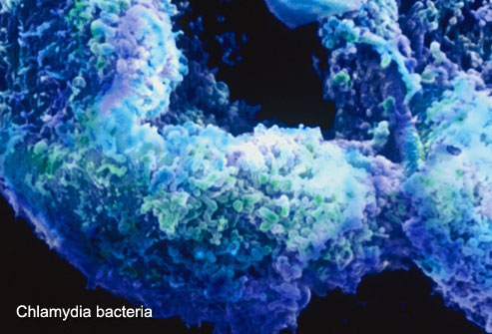
Chlamydia

Slide 15
Gonorrhea
Bacterial STD, infecting 650,000 each year
Although many may have no symptoms at all, symptoms may include a burning sensation when urinating or abnormal discharge. In women, symptoms may be mild and mistaken for a vaginal infection
Transmitted to either partner through vaginal, anal or oral sex and is diagnosed through lab tests
Can be cured through antibiotics but remains a common cause of PID, which can lead to infertility and life threatening pregnancies
In men, gonorrhea can cause a painful condition in the tubes attached to the testicles. In rare cases, this may cause a man to be sterile, or prevent him from being able to father a child.

Slide 16
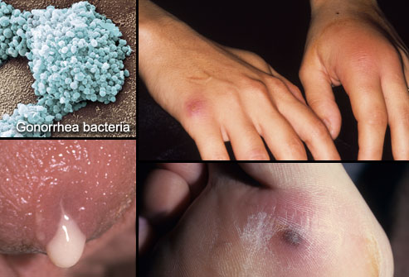
Gonorrhea

Slide 17
Genital Herpes- HSV 2
Viral STD and infects 1 million people each year in the US, including 650,000 people aged 15-24
Most widespread in the US today, with 45 million currently infected
Over 90% of people that tested positive for genital herpes did not know they had it
Incurable- Have it for life
Symptoms: painful, reoccurring blisters or sores on or around the genitals or rectum
Transmitted through sexual contact, including vaginal, oral and anal sex with an infected partner
Medications can help with outbreaks

Slide 18
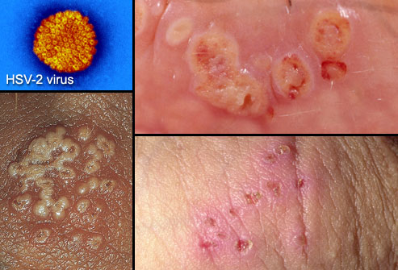
Genital Herpes

Slide 19
HIV/AIDs
AIDS is caused by Human Immunodeficiency Virus (HIV). More than 1 million Americans may be infected with HIV with ¼ unaware of their infection
AIDS is most often treated through sexual contact
Spread through sexual contact, contact through infected blood, sharing contaminated needles, or through childbirth
Many do not show symptoms when first infected, but some show flu-like illness within a month or two.
Fever, headache, tiredness and enlarged lymph nodes- disappear within a week to month
Spreads quick and kills cells in the immune system
Incurable- drugs can suppress the virus, but do not cure HIV infection

Slide 20
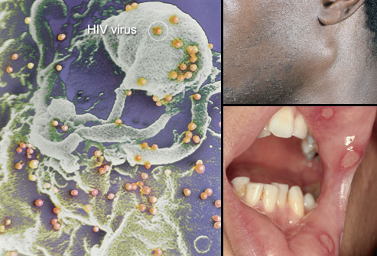
HIV/AIDS

Slide 21
Syphilis
Can cause long-term complications if not treated correctly. Symptoms in adults are divided into stages. These stages are primary, secondary, latent, and late syphilis.
Bacterial infection- treatable by antibiotics
Can get by direct contact with a syphilis sore during anal, vaginal, or oral sex. Sores can be found on the penis, vagina, anus, in the rectum, or on the lips and in the mouth. Syphilis can also be spread from an infected mother to her unborn baby.
Symptoms: Starts with a painless sore, which goes away after 3-6 weeks. However- the infection is not gone
Secondary stage- skin rashes or sore in mouth, vagina or anus. Rash is rough, red or reddish brown spots. Other signs are fever, sore throat, headaches, weight loss. Again will go away
Latent and late stage- Can have for years without knowing. Difficulty coordinating muscle movements, paralysis, organ damage and death

Slide 22
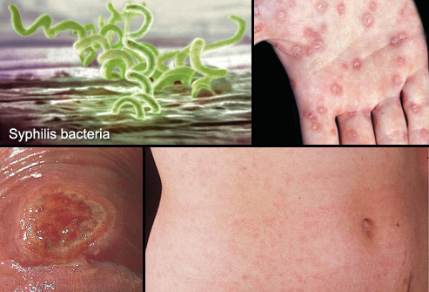
Syphilis

Slide 23
HPV: Human Papilloma Virus
Virus- most common sexually transmitted infection in the US
You can get HPV by having oral, vaginal, or anal sex with someone who has the virus. It is most commonly spread during vaginal or anal sex. HPV can be passed even when an infected person has no signs or symptoms.
In most cases, HPV goes away on its own and does not cause any health problems. But when HPV does not go away, it can cause health problems like genital warts and cancer. Take note- it is a virus, so you have the virus for life.
HPV can cause cervical and other cancers including cancer of the vulva, vagina, penis, or anus. It can also cause cancer in the back of the throat, including the base of the tongue and tonsils. Cancer often takes years to develop
Prevention: Series of shots for males and females
No symptoms

Slide 24

STDs
Are You Positive
that You Are Negative?

Slide 25
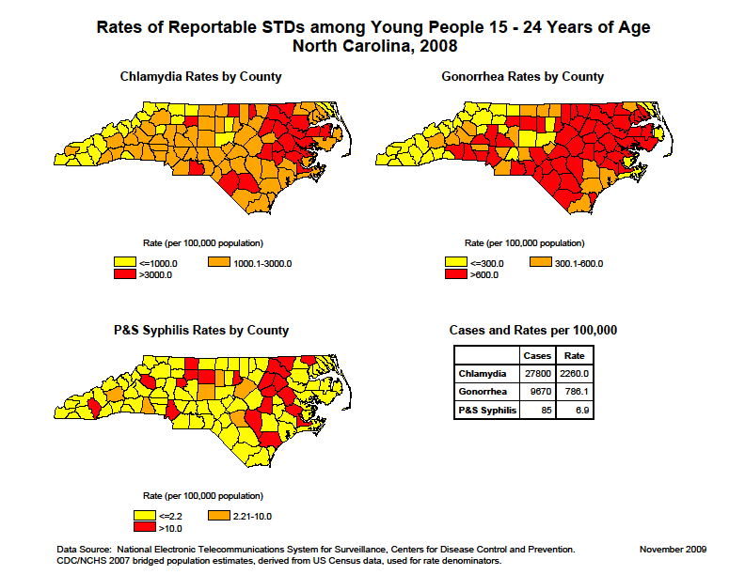

Slide 26

Do I Need To Get Tested ?
Anyone who has ever had sexual intercourse
Noticeable signs and symptoms
Annual STD exam
Pap smear does not equate to STD exam

Slide 27
In a new relationship, trust but verify…
Get tested together!

Slide 28
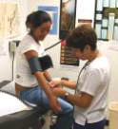
Signs and Symptoms
Females
MOST STDs have NO symptoms
Discharge from vagina (yellow, greenish or gray)
Bleeding from vagina between periods
Burning/pain when you urinate or have a bowel movement
Pain in abdomen
Small bumpy warts
Itching/burning
Small painful blisters
Unexplained weight loss
Flu-like symptoms
White spots in the mouth

Slide 29

Signs and Symptoms
Males
Many STDs have NO symptoms
Watery, white drip from penis
Burning or pain when you urinate or during a bowel movement
Need to urinate more often
Swollen or tender testicles
Small, bumpy warts
Small painful blisters
Thick yellow or greenish drip from penis

Slide 30

Do I Have To Tell Everything?
Discuss sexual history with doctor/nurse
Honesty improves options for prevention methods and treatment
Ask questions

Slide 31

Provider Questions
A person who seeks STD testing might be asked about the following behaviors:
Number of sexual partners
Types of sexual behaviors (oral, anal, or vaginal intercourse)
Pregnancy prevention practices
STD prevention practices
STD history (individual and partner)

Slide 32
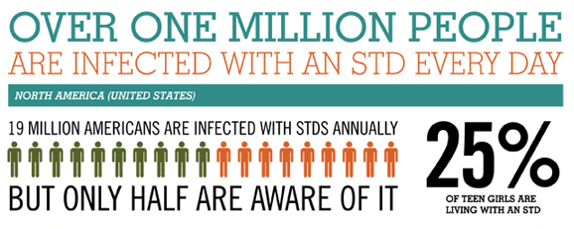
Which STDs Can I Get Tested For?
Chlamydia
Gonorrhea
Trichomoniasis
HPV (if symptomatic)
Herpes (if symptomatic)
Pelvic Inflammatory
Disease (PID)
Syphilis
HIV
Bacterial Vaginosis

Slide 33
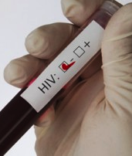
HIV Test Procedure
Consent Form
Risk Assessment
Blood Test
Syphilis Test
Test Results 20 minutes – 3 weeks
Test Results
Risk Reduction

Slide 34
The Limits of Condoms
While condoms are effective in preventing the spread of some STDs, they are not perfect. Condoms are better at protecting against gonorrhea, chlamydia, HIV.
They offer less protection against herpes, syphilis, and genital warts. These infections can spread through contact with skin lesions that are not covered by a condom. Finally, condoms offer virtually no protection against crabs and scabies.

Slide 35
Negotiating Condom Use
The Goal: To protect yourself and your partner from STDs and/or pregnancy
Content: Clear, specific. Use words like I feel, Think, Want
Voice: Clear, even, don’t hesitate
Facial Expression: Give direct eye contact
Posture: Self-assured
Your feelings: Confident of your feelings and decisions, self-respecting
Another’s feelings: Respected

Slide 36
Guided Practice
Pressure Lines: Recall the skills needed for negotiating condom use.
Work with a partner. One will be the “pressure” The other partner will be the “refusal”
The pressure will read the lines and the partner will give a reply that is assertive and is a refusal. Switch roles after each question

Slide 37
Independent Practice
Looking Ahead Worksheet
Consider the following questions and explain how you would address each question.

Slide 38
Lesson 8
9.ICR.3 Create strategies that develop and maintain reproductive and sexual health
9.ICR.3.4 Exemplify decision making skills and problem solving regarding safe and effective use of methods to prevent unintended pregnancy

Slide 39
Statement of Objectives
In this lesson we consider the possible outcomes of sexual activity, specifically focusing on unintended pregnancy at a young age and its consequences. The lesson will help you examine your long-term goals and how a teen pregnancy would impact them. By the end of today’s lesson, you will be able to use decision making skills to choose safe and effective methods to prevent unintended pregnancy

Slide 40
Reducing the Risk
Arrange 8 cards in order of least effective of preventing pregnancy to most effective to preventing pregnancy
Choices: No contraception, IUD, Diaphragm, Oral-The Pill, Spermicidal Foam, Abstinence, Male Condom, Depo-Provera Shot
Next, which ones are effective for preventing STDs?

Slide 41
Reducing the Risk
Method | Failure Rate- Typical User | HIV/STD Prevention
No contraception | 85% | None
Spermicidal foam | 29% | None
Male condom | 15% | Most effective against HIV, less risk reduction against other STDs
Diaphragm | 16% | None
Oral- The Pill | 8% | None
Depo-Provera shot | 3% | None
IUD | Less than 1% | None
Abstinence | 0% | 100%

Slide 42
View Power point: Methods of Contraception

Slide 43
Teen Files: The Truth About Sex
http://app.discoveryeducation.com/player/view/assetGuid/0CFCFD0D-525D-4AEC-8C4A-40B7E8B7BE7A

Slide 44
Checking Comprehension
Complete all questions on the front side
When finished, turn the worksheet over and complete the word search

Slide 45

What 50 Years of Research Tells Us about a Teen’s Mom Future
A teenage girl who gets pregnant has written 90% of her life’s script.

Slide 46
A teenage girl who gets pregnant has written 90% of her life’s script
How does this make you feel and why is the statement true?
Is it different for teen fathers?

Slide 47
Too Young
www.thenationalcampaign.org/tooyoung

Slide 48
Two skills that can help a teen decrease the chances of being a parent before he or she is ready are decision making and goal setting

Slide 49
Decision Making for Health
examines barriers to healthy decision making;
determines value of applying thoughtful decision making;
justifies when individual or collaborative decision making is appropriate;

Slide 50
Decision Making for Health
(continued)
generates alternatives;
predicts potential short-term and long-term impact of alternatives; and
defends healthy choices and evaluates effectiveness of health-related decisions.

Slide 51
Goal-Setting for Health
assesses personal health practices and health status;
develops a plan to attain a personal health goal;
implements strategies, including self-monitoring, to achieve the goal; and
formulates effective long-term personal health plan.

Slide 52
5 Step Decision-Making Model
Describe the situation that requires a decision
Brainstorm options. Consider recourses required
Evaluate the consequences of each decision
Choose the best decision and create a plan of action
Act on your decision and evaluate the results

Slide 53
Group work
Separate into groups of 2-3
You will be think about how to apply a decision making plan to a young person’s life
I will give you a brief description of your teen, including their sex and age.
You:
Give your teen a name and description
Create short term and long term goals- consider some of your own goals for this activity

Slide 54
Next
I want you to think about your teen being sexually active
Using the Applying the Model handout, apply the decision making model to help your teen work through the process, taking into consideration his/her short term and long term goals

Slide 55
When finished, join with another group and share:
Common short and long term goals?
Was there a relationship between sexual activity and accomplishing these goals?
What were some of the options for the teen that you came up with
What were the consequences?

