Slide 1
ICR Lesson 6
9.ICR. 2 Evaluate abstinence from sexual intercourse as a positive choice for young people
9.ICR.2.2 Explain the consequences of early and unprotected sexual behaviors

Slide 2
Review- Carousel Brainstorming Warm Up
Make 4 columns on your ICR Notes
Label the 4 columns Physical Health, Mental Health, Emotional Health, Social Health
Under those columns, list what it means to be healthy under those domains

Slide 3
Statement of Objectives
We know we need to be healthy in several domains: physically, mentally, emotionally, and socially. Making healthy choices or taking risks can affect all these domains of our lives. Today we will talk about the benefits of sexual abstinence in all the domains of health

Slide 4
“The future is NOW”
Let’s apply this quotation to being a teenager and planning for the future.
On your ICR Notes, write 5 behaviors you might practice today which would determine the quality of your life in the years ahead
Make sure to include that at least 2 decisions are health-related

Slide 5
List 5 decisions you will make today

Slide 6
What is
Sexual Abstinence?
Voluntarily refraining from intimate sexual behavior which could lead to unintended pregnancy or disease
  Includes oral, anal, or vaginal sex

Slide 7

Why be abstinent?
Personal Reasons:
Not ready/too young
Could disrupt future plans
and dreams
Waiting till marriage
Want to protect reputation
Might have serious regrets

Slide 8
Why be abstinent?
Health Reasons:
To avoid unintended pregnancy
To avoid a sexually transmitted disease
To avoid cervical cancer (females)
To avoid stress and lower self-esteem
Some consequences are life-altering (such as an STD which cannot be cured or an unintended pregnancy).

Slide 9
Why be abstinent?
Relationships Reasons:
Don’t want to hurt or be hurt
Don’t want to disappoint parents
Want to build a friendship
Want to have trust and commitment in the relationship
To practice skills needed
for fidelity in marriage

Slide 10

What strategies are helpful?
Avoid “risky” situations:
Avoid alcohol and drugs
Avoid places and situations which could lead to sex
Plan to be with others
or supervised by adults

Slide 11

What strategies are helpful?
Communicate effectively:
Set personal limits and
express those to the
other person
Be confident in the decision
Say “no” firmly
Be consistent with body language

Slide 12
What strategies are helpful?
Try to maintain the friendship UNLESS the person appears to disrespect your wishes by:
Continuing to pressure you
Trying to force you
Encouraging you to use alcohol or drugs

Slide 13
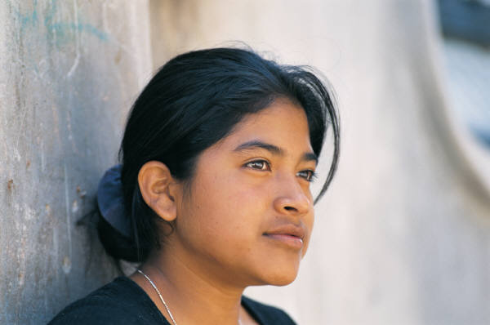
What strategies are helpful?
Have a Plan “B”:
If someone continues to pressure you beyond your personal limits, what will you do?
Hmmm . . . What should I do?

Slide 14
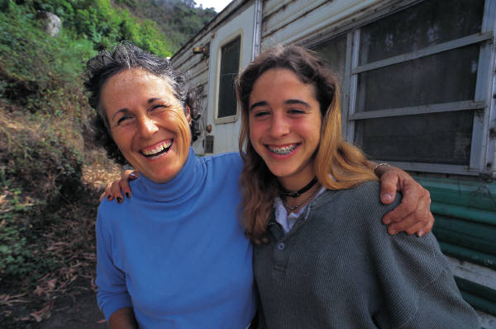
Who supports your decision to be abstinent?
Parent(s), guardian(s)
Peers who respect your values
Teachers, counselors, nurses
Faith leaders
Youth leaders
Extended family

Slide 15
Guided Practice
Whatcha Gonna Say Worksheet
Think about the skills you have just seen and apply the concepts to share advice with a classmate

Slide 16
Independent Practice
Geometry Review
Complete the questions on the Geometry Review

Slide 17
Closure
Most of us know the health reasons for avoiding intimate sexual behavior. There are equally important reasons to choose abstinence to protect our social and emotional health. We can see abstinence is the best choice for young people

