Slide 1
Depression
9.MEH 2.1Identify causes and symptoms of depression and mental disorders

Slide 2
Kyle’s Story
Causes of his depression?
Signs and symptoms of mental illness
Do you think it was difficult for Kyle to seek help?
How did the narrator of the story help Kyle through his freshman year?
Did the narrator have any idea of the impact he made on Kyle’s outlook of life?

Slide 3
Phone Booth Activity
Work in groups of 7
Identify the continuum of the scenarios ranging from SAD------DEPRESSED-----SUICIDAL
Place up on board your groups continuum
Be prepared to discuss why you chose your order

Slide 4
Phone Booth
Why do we all have different ideas about where to place these different situations along the continuum?
Can two individuals react differently in the same situation? What makes the difference?

Slide 5
What is depression?
People with major depressive disorder (clinical depression) are subject to a deep and long-lasting sense of sadness and loss of pleasure.
Have feelings that disrupt your ability to work, play, eat, sleep and concentrate that last for weeks, months, or even years
It can be treated
Clinical depression can also be an illness when the feelings of sadness, hopelessness and despair persist and interfere with an individual’s ability to function

Slide 6
How can we deal with depression/stress?
With partners:
Identify a situation where it may lead to depression or worse for someone of your age.
Identify as many positive ways for a teen to cope with that situation

Slide 7
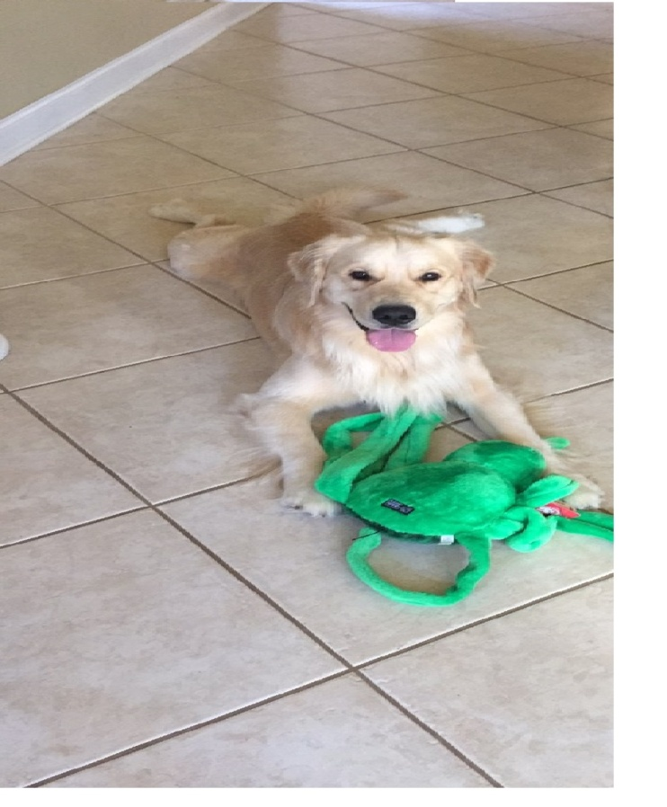
Dealing with stress
Taking care of our bodies -Eat healthy -Get enough sleep -Exercise
Ask for help when you need it
Don’t be too hard on self
Determine if the stressor is within your control
Adopt a pet

Slide 8
Dealing with Stress
Medication: After a thorough physical and diagnostic evaluation, medications is often used in the treatment of depression and other mental disorders.
Doctors consider the type of depression or disorder the patient suffers from, other medications he or she is taking, age and how well he or she will deal with the side effects
Some cases, patients have to try three, four or more medications before one works

Slide 9
Serious stressors can become overwhelming when we are not equipped with good coping skills.
Not only do we need to be able to recognize signs of depression in our friends, we also need to recognize those signs in our own behaviors.
When this happens, we can and must reach out for help

Slide 10
In any given year, 20% of American children will be diagnosed with a mental illness
There are many factors, including heredity and brain chemistry that might be involved in the development of a mental disorder.
As such, many mental disorders can be effectively treated with medication, psychotherapy( a type of counseling), or a combination of both

Slide 11
Guided Practice
Create a pamphlet about youth depression or one of the mental disorders that young people develop
Include: Statistics about the illness or disorder Signs and symptoms Where or who to go for help Treatment for youth

Slide 12
Basic questions to research
What percentage of adolescents may suffer from this disorder?
Who can help these young people?
What types of treatments have been found successful for treating youth?
How many adolescents are actually receiving treatment for this disorder?
Are there certain symptoms that are found more often in youth than adults?
Target audience- high school youth

Slide 13
Independent Practice
Create a list of 7 causes and 7 symptoms of depression- be creative and create a diverse list!
Ask 3 individuals to rank each of the causes and symptoms from most common to least common. 1 is least common and 7 is most common
After survey has been created, enter data into a “Wordle”
www.wordle.net Be prepared to share findings—most common

Slide 14
Reflection
Do any of the results surprise you?
Does the collected data match your own personal rankings? If not, what is different?
Is it possible for two people to have the same cause for depression yet display completely different symptoms? How could this happen?
How could stereotyping limit one’s ability to recognize the many causes and symptoms of depression? Does this data show any signs of stereotyping?
Do you think there is one particular cause and/or symptom of depression that is often overlooked in our society? If so, why?

