Slide 1
ATOD Lesson 2
9.ATOD 2. Apply risk reduction behaviors to protect self and others from alcohol, tobacco and other drug
9.ATOD 2.1 Identify ways to avoid riding in a car or engaging in other risky behaviors with someone who is under the influence of alcohol or other drugs
9.ATOD. 2.2 Use strategies for avoiding binge drinking

Slide 2
Today we are going to analyze the risks involved in consuming alcohol and/or drugs and operating an automobile and identify ways to avoid riding with someone or engaging in other risky behaviors with someone who is under the influence of alcohol or other drugs.

Slide 3
Death of an Innocent
http://fsd79.schoolwires.net/cms/lib/IL01001571/Centricity/Domain/547/Poem%20for%20review-study%20session.pdf
https://www.youtube.com/watch?v=NDHr4ENgUiQ
Answer the following questions on Page 1- ATOD Notes
1. How does this poem make you feel?
2. Why do individuals drive a car after they have consumed alcohol even though everyone knows it is a risky behavior?
3. 1 paragraph reflection on poem- how you feel, consequences of drinking and driving, why does drinking and driving happen?

Slide 4
Video: Two Sister’s Tragic Story
http://www.youtube.com/watch?v=oNrh0uILyUQ&feature=endscreen&NR=1

Slide 5
Questions- answer on ATOD Notes
1. What were some of your thoughts as you watched the video?
2. How would you feel if you lost a loved one to a drinking and driving accident?
3. What would you want the consequences to be for that driver who killed someone you loved?
4. How would you feel if you were the driver who had been drinking alcohol and someone was seriously injured or killed in your car or the other car in the accident?
5. When would you get over that guilt?
6. Will it take losing a friend or a family member to convince people not to drive after they have been drinking?
7. What can the consequences for a driver who causes a death in an alcohol-related accident?

Slide 6
What is the legal driving while impaired (DWI) limit?
0.08 Blood Alcohol Level
Can a driver be arrested and convicted of a DWI charge even though their BAL is below the legal limit of .08?
Yes, all they have to prove is that the driver’s ability to drive is impaired

Slide 7
Legal Consequences for a DWI conviction?
Adult: Loss of license for 1 year, fine, court costs, lawyer fees, community service, car insurance triples
Teen: Loss of license until 18 years of age, fine, court costs, lawyer fees, community service, car insurance triples- and teen’s insurance premiums are much higher than adults

Slide 8
Drinking and Driving PPT

Slide 9
Are there other decisions, other than getting in a car with someone who has been drinking, that a person may make while drinking?

Slide 10
Unintentional injuries
Get into a physical fight- 17.1% of students have gotten into trouble with their family or friends, missed school, or gotten into fights, while using alcohol or drugs
Unwanted, unplanned, or unprotected sexual activity- 25.3% among students who had sexual intercourse during the past 3 months drank alcohol or used drugs before last sexual intercourse

Slide 11
Dating abuse
Sexual Assault
Abuse of other drugs
Higher risk of suicide or homicide- alcohol is involved in over 50% of all homicides and suicides

Slide 12
21% of high school students rode in a car or other vehicle driven by someone who had been drinking alcohol one or more times during the past 30 days

Slide 13
6.3% of high school students drove a car or other vehicle when they had been drinking alcohol one or more times during the past 30 days

Slide 14
8.4% vs. 4%
Male students were more likely than female students to drive a car or other vehicle when they had been drinking alcohol one or more times during the past 30 days

Slide 15
17.6% of students had 5 or more drinks of alcohol in a row, within a couple of hours, on or more of the past 30 days

Slide 16
Zero Tolerance Law
Illegal for anyone under 21 to purchase and possess alcohol
Criminal DUI offense for drivers under the age of 21 to drive with even a small amount of alcohol in their system
Why? 1/3 of teenage deaths result from motor vehicle accidents, with 35% of fatalities are alcohol related

Slide 17
Reality Matters
Questions- write the questions on notebook paper:
What are your feelings about the two father’s actions about holding the under-aged drinking party for their daughters?
What did the research study show about the two teenage brains?
What were the results of K.T.’s drinking?
What are the long term affects of drinking for teenagers?

Slide 18
Reality Matters Video
http://app.discoveryeducation.com/player/view/assetGuid/7D773D69-A9C7-461E-9091-8790DD4634D6

Slide 19
What Would You Do Warm Up
You complete part 1 of your situation
When finished, find a partner that has the opposite part and share
Your part must be at least 6 sentences and answer all the questions!

Slide 20
Warm up: Answer the following ?’s on ATOD Notes- TRUE OR FALSE
1. Alcohol is a stimulant
2. Under the influence of alcohol, everything may appear to be fuzzy; drinkers may slur their words and have difficulty hearing, tasting, and smelling.
3. Under the influence of alcohol, a drinker’s ability to think, speak, and move may slow way down.
4. Under the influence of alcohol, drinkers are usually calm, thoughtful, and easygoing.
5. Alcohol will help a person sleep.
6. People attending a winter football game should drink alcohol to keep warm.

Slide 21
Answers
1. False- alcohol is a depressant
2. True- Alcohol slows down the cerebral cortex as it works with information from your
senses.
3. True- When you think of something you want your body to do, the central nervous system—the brain and the spinal cord—sends a signal to that part of the body. Alcohol slows down the central nervous system, making you think, speak, and move slower
4. False- When alcohol affects the frontal lobes of the brain, you may find it hard to control your emotions and urges. You may act without thinking or even become violent. Drinking alcohol over a long period of time can damage the frontal lobes forever.
5. False- hypothalamus is a small part of the brain that does an amazing number of your body’s housekeeping chores. Alcohol upsets the work of the hypothalamus
6. False- The medulla controls your body’s automatic actions, such as your heartbeat. It also keeps your body at the right temperature. Alcohol actually chills the body. Drinking a lot of alcohol outdoors in cold weather can cause your body temperature to fall below normal. This dangerous condition is called hypothermia.

Slide 22
Binge Drinking: Nicholas Trout: Another High School Student Dies of Alcohol Poisoning
Why do some people choose to abuse alcohol?
What are some of the possible negative consequences of alcohol abuse?
What would be the impact on your loved ones if you were to die from an alcohol overdose?

Slide 23
BAC
Blood Alcohol Concentration
Definition: Percentage of alcohol in the bloodstream
What is the legal limit for teens?

Slide 24
Alcohol is a
Depressant: loose coordination, inability to feel pain, become unconscious, more likely to get the blues

Slide 25
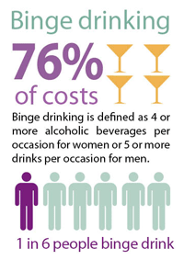
Binge Drinking
A pattern of drinking that brings a person’s blood alcohol concentration (BAC) to .08.
Usually: Men 5 drinks or more and women 4 drinks or more in 2 hours
1 in 6 or 38 million adults binge drink
4x: Binge drinkers do so about 4 times a month
Largest number of drinks per binge on average is 8

Slide 26
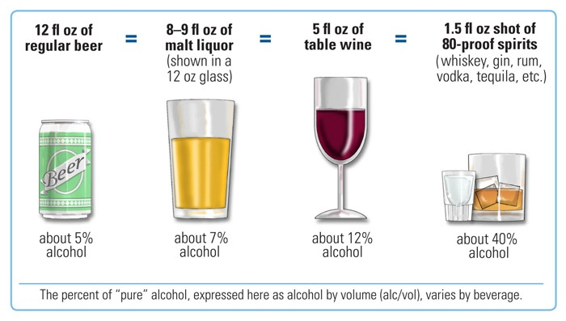
What is a drink?
One 12oz beer
5oz glass of wine
1.5oz of liquor (80 proof)

Slide 27
Binge drinking can lead to:
Motor vehicle crashes
Violence
Spread of STDs
Unplanned pregnancies
Fetal Alcohol Syndrome
Alcohol dependence
Unintentional injuries
Liver disease

Slide 28
What is the problem?
Injury: 599,000 students between the ages of 18 and 24 receive unintentional injuries while under the influence of alcohol.
Assault: More than 690,000 students between the ages of 18 and 24 are assaulted by another student who has been drinking.
Sexual Abuse: More than 97,000 students between the ages of 18 and 24 are victims of alcohol-related sexual assault or date rape.

Slide 29
What is the problem?
Academic Problems: About 25 percent of college students report academic consequences of their drinking including missing class, falling behind, doing poorly on exams or papers, and receiving lower grades overall.
Health Problems/Suicide Attempts: More than 150,000 students develop an alcohol-related health problem and between 1.2 and 1.5 percent of students indicate that they tried to commit suicide within the past year due to drinking or drug use.

Slide 30
Result of binge drinking
80,000 deaths in the US each year
Cost the economy 223.5 billion in 2006
Age group with the most binge drinkers: 18-24 yrs
Income group with the most binge drinkers: more than 75,000
Income group that binge drinks the most often and drinks most per binge: less than 25,000

Slide 31
Binge Drinking
Most people who binge drink are not alcohol dependent or alcoholics
More than half of the alcohol adults drink is while binge drinking
More than 90% of the alcohol youth drink is while binge drinking

Slide 32
Effects on the body: Brain
Alcohol interferes with the brain’s communication pathways, and can affect the way the brain looks and works. These disruptions can change mood and behavior, and make it harder to think clearly and move with coordination.
Brain continues to develop until the age of 20

Slide 33
Effects on the body: Heart
Drinking a lot over a long time or too much on a single occasion can damage the heart, causing problems including: Can cause stretching and drooping of heart muscle Can cause irregular heart beats Stroke High blood pressure

Slide 34
Effects on the body: Liver
Heavy drinking takes a toll on the liver, and can lead to a variety of problems and liver inflammations including:
Fatty liver
Alcoholic hepatitis
Fibrosis
Cirrhosis

Slide 35
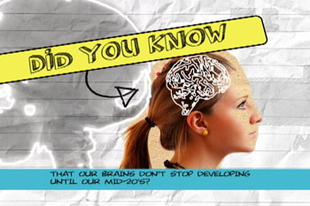
Did You know?
Underage drinking can make you act and look stupid. Alcohol can make you feel more social and daring, but it actually is a depressant that slows down parts of your brain. That’s why people who have been drinking behave in ways they never would while sober.
Underage drinking makes you accident prone. Alcohol interferes with your vision, coordination, and concentration by acting as a sedative on your central nervous system. Nearly 190,000 12-to 20-year-olds wind up in an emergency room each year for alcohol-related problems. (The majority of those who do are male.)
Substance Abuse and Mental Health Services Administration
Center for Substance Abuse Prevention

Slide 36
Each year,
About 5,000 young people under the age of 21 die as a result from underage drinking
1,900 deaths from motor vehicle crashes
1,600 from homicides
1,200 from alcohol poisoning, falls, burns, and drowning
300 from suicides

Slide 37
What can you do?
Choose not to binge drink
Support the minimum legal drinking age of 21

Slide 38
Alcohol Poisoning
Caused from drinking large amounts of alcohol in a short period of time
Drinking too much too quickly can affect your breathing, heart rate, body temperature and gag reflex and potentially lead to coma and death.

Slide 39
Critical Signs
Mental confusion, or the person cannot be wakened
Vomiting
Seizures
Slower breathing (fewer than 8 breaths per minute)
Irregular breathing (10 seconds or more b/t breaths)
Hypothermia (low body temperature), bluish skin color or paleness

Slide 40
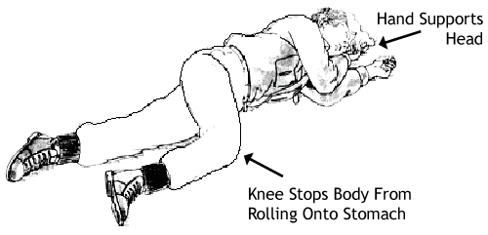
What Should I Do?
If there is any suspicion, call 911 for help.
Know the danger signals
Do not wait for all symptoms to be present
Be aware that a person who has passed out may die
Lie person on the side

Slide 41
What can happen?
Victim chokes on his or her vomit
Breathing slows, becomes irregular or stops
Heart beats irregularly or stops
Hypothermia (low body temperature)
Hypoglycemia (too little blood sugar) leads to seizures
Untreated severe dehydration from vomiting can cause seizures, permanent brain damage or death

Slide 42
Drinking Wheel Activity
http://www.intox.com/wheel/drinkwheel.asp - use for drinking wheel
http://en.wikipedia.org/wiki/Blood_alcohol_content - use for effects
http://www.brad21.org/effects_at_specific_bac.html - use for effects

Slide 43
Guided Activity: Fishbowl
Divide the class in two groups
One group will go first and engage in a discussion while the second group listens
After the discussion, groups will switch
Getting a participation grade: 20 points
Each time you talk out of turn – 2 points Need to talk at least 2 times to get full credit- may not speak a second time until everyone has had a chance
Participants have the right to pass 10 minutes per group

Slide 44
Independent Practice
Write a letter to an editor and include the following elements – 30 point grade
What is binge drinking
Who is affected by binge drinking
Why the issue is important
How to change binge drinking behavior
Must be at least 2 paragraphs
Turning this in at the end of class

Slide 45
Binge Drinking Video
http://app.discoveryeducation.com/player/view/assetGuid/48496104-0978-4C18-A46C-E80916E87BC2

Slide 46
Word Bank: Steroids Crossword
Teenagers Stacking
Orally Steroid Psychosis
Cycling Illegal
Pyramiding Anabolic
Shared
Roid Rage
Increase
Androgenic
Anabolic Steroids
Testosterone
Prescription

