Slide 1
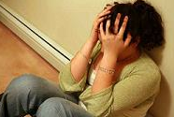
Mental Disorders and Symptoms

Slide 2
Warm Up
Responses to How to Handle a Problem worksheet

Slide 3
Sources of Help for Mental and Emotional Disorders
Parent or family member: Families are built in support systems. A support system is a network of people available to help when needed
Mental Health professional: These people are specially trained to understand and deal with mental and emotional problems. They respect your privacy
School nurse: Specially trained to understand and deal with problems of teenagers.

Slide 4
Sources of Help for Mental and Emotional Problems
Priest, Minister, Rabbi, or other clergy member: The leader of your faith community may be a good person with whom to talk. Members of the clergy are educated in counseling people with emotional problems.
Teacher or school counselor: A teacher or guidance counselor whom you like and trust could be a friend when you are in need.
Hot Line: Teen hot lines are special telephone services. Some are answered by teens, others by adults. Both groups are trained to listen and help teens that are experiencing a crisis

Slide 5
Hot Line
Hope Hot Line (NC): 919-231-4525
Teen Line (CA): 310 855 HOPE 9pm-1 Text TEEN to 839863 between 8:30pm-12:30 PST to speak with one of their teens. Text STOP to stop

Slide 6
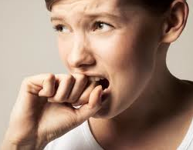
General Anxiety Disorder (GAD)
Definition: Severe, ongoing anxiety that interferes with day to day activities.
Treatment methods:
medication and/
or therapy
Notes:
http://www.mayoclinic.com/health/generalized-anxiety-disorder/DS00502

Slide 7
Social Phobia (Social Anxiety Disorder)
Definition: Social phobia is a strong fear of being judged by others and of being embarrassed.
Similar to GAD, Social Phobia can also interfere with day to day activities.
Treatment methods:
medication and or
therapy/counseling
Notes:
http://www.nimh.nih.gov/health/publications/social-phobia-social-anxiety-disorder-always-embarrassed/what-is-social-phobia.shtml

Slide 8
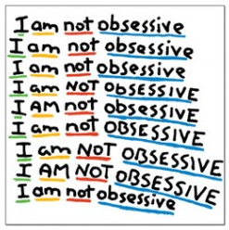
Obsessive-Compulsive Disorder (OCD)
Definition: OCD is an anxiety disorder that leads people to performing repetitive tasks that interfere with everyday life.
Treatment Methods:
medication and
behavioral therapy

Slide 9
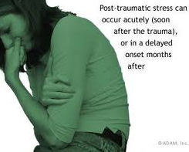
Post Traumatic Stress Disorder (PTSD)
Definition: A mental health condition that is triggered by a terrifying event. Symptoms may include nightmares, flashbacks and severe anxiety.
Treatment Methods:
therapy and or
medication
Notes:
http://www.mayoclinic.com/health/post-traumatic-stress-disorder/DS00246

Slide 10
Panic Disorder
Definition: An involuntary anxiety or “panic” attack, triggering severe physical reactions.
Treatment Methods:
medication and/
or therapy
Notes:
http://www.mayoclinic.com/health/panic-attacks/DS00338

Slide 11
Barriers
What is a barrier?
What could be a barrier to seeking help for a mental disorder?

Slide 12
Barriers to Seeking Help for Mental Disorders
Perception that problem will “just go away”
Perception that a mental health problem means one is weak or crazy
Lack of awareness of resources at school or community
Embarrassment to acknowledge problem
Perception that one should be able to fix the problem without help

Slide 13
Barriers to Seeking Help
Why might this particular barrier be so prevalent(widespread) in our daily lives?
What ideas do you have for overcoming these barriers?
Why is it that people feel more comfortable addressing a physical health problem but not a mental health problem?

Slide 14
Statistics
Approx. 1 in 10 children aged 5-16 suffer from a diagnosable mental health disorder- that is around 3 adolescents in each class
Nearly 80,000 children and young people suffer from severe depression
Between 500,000 and one million young people aged 15-24 attempt suicide each year

Slide 15
Matching Symptoms
Worksheet: Match the mental disorders we discussed in class to the correct symptoms

Slide 16
Do you know someone who…
Put all notes away
Each bag has 5 mental disorders with matching symptoms and treatments.
Match the correct disorders to the symptoms by placing in a line on the desk
Work in groups of 3-4. No more than 4!!

Slide 17
Free Write
Select one of the 5 mental disorders and create a story about the struggles that may be faced when encountered with a particular mental disorder
Be sure to include symptoms and help-seeking strategies that can be played out by the individual or friend.
Rubric: 15 points -5 points: Correctly identifies a mental disorder and shows correct symptoms -5 points: Displays positive coping strategies and help-seeking strategies -5 points: Correct grammar, spelling, punctuation. At least 3 paragraphs (opening, body, closing)

