Slide 1
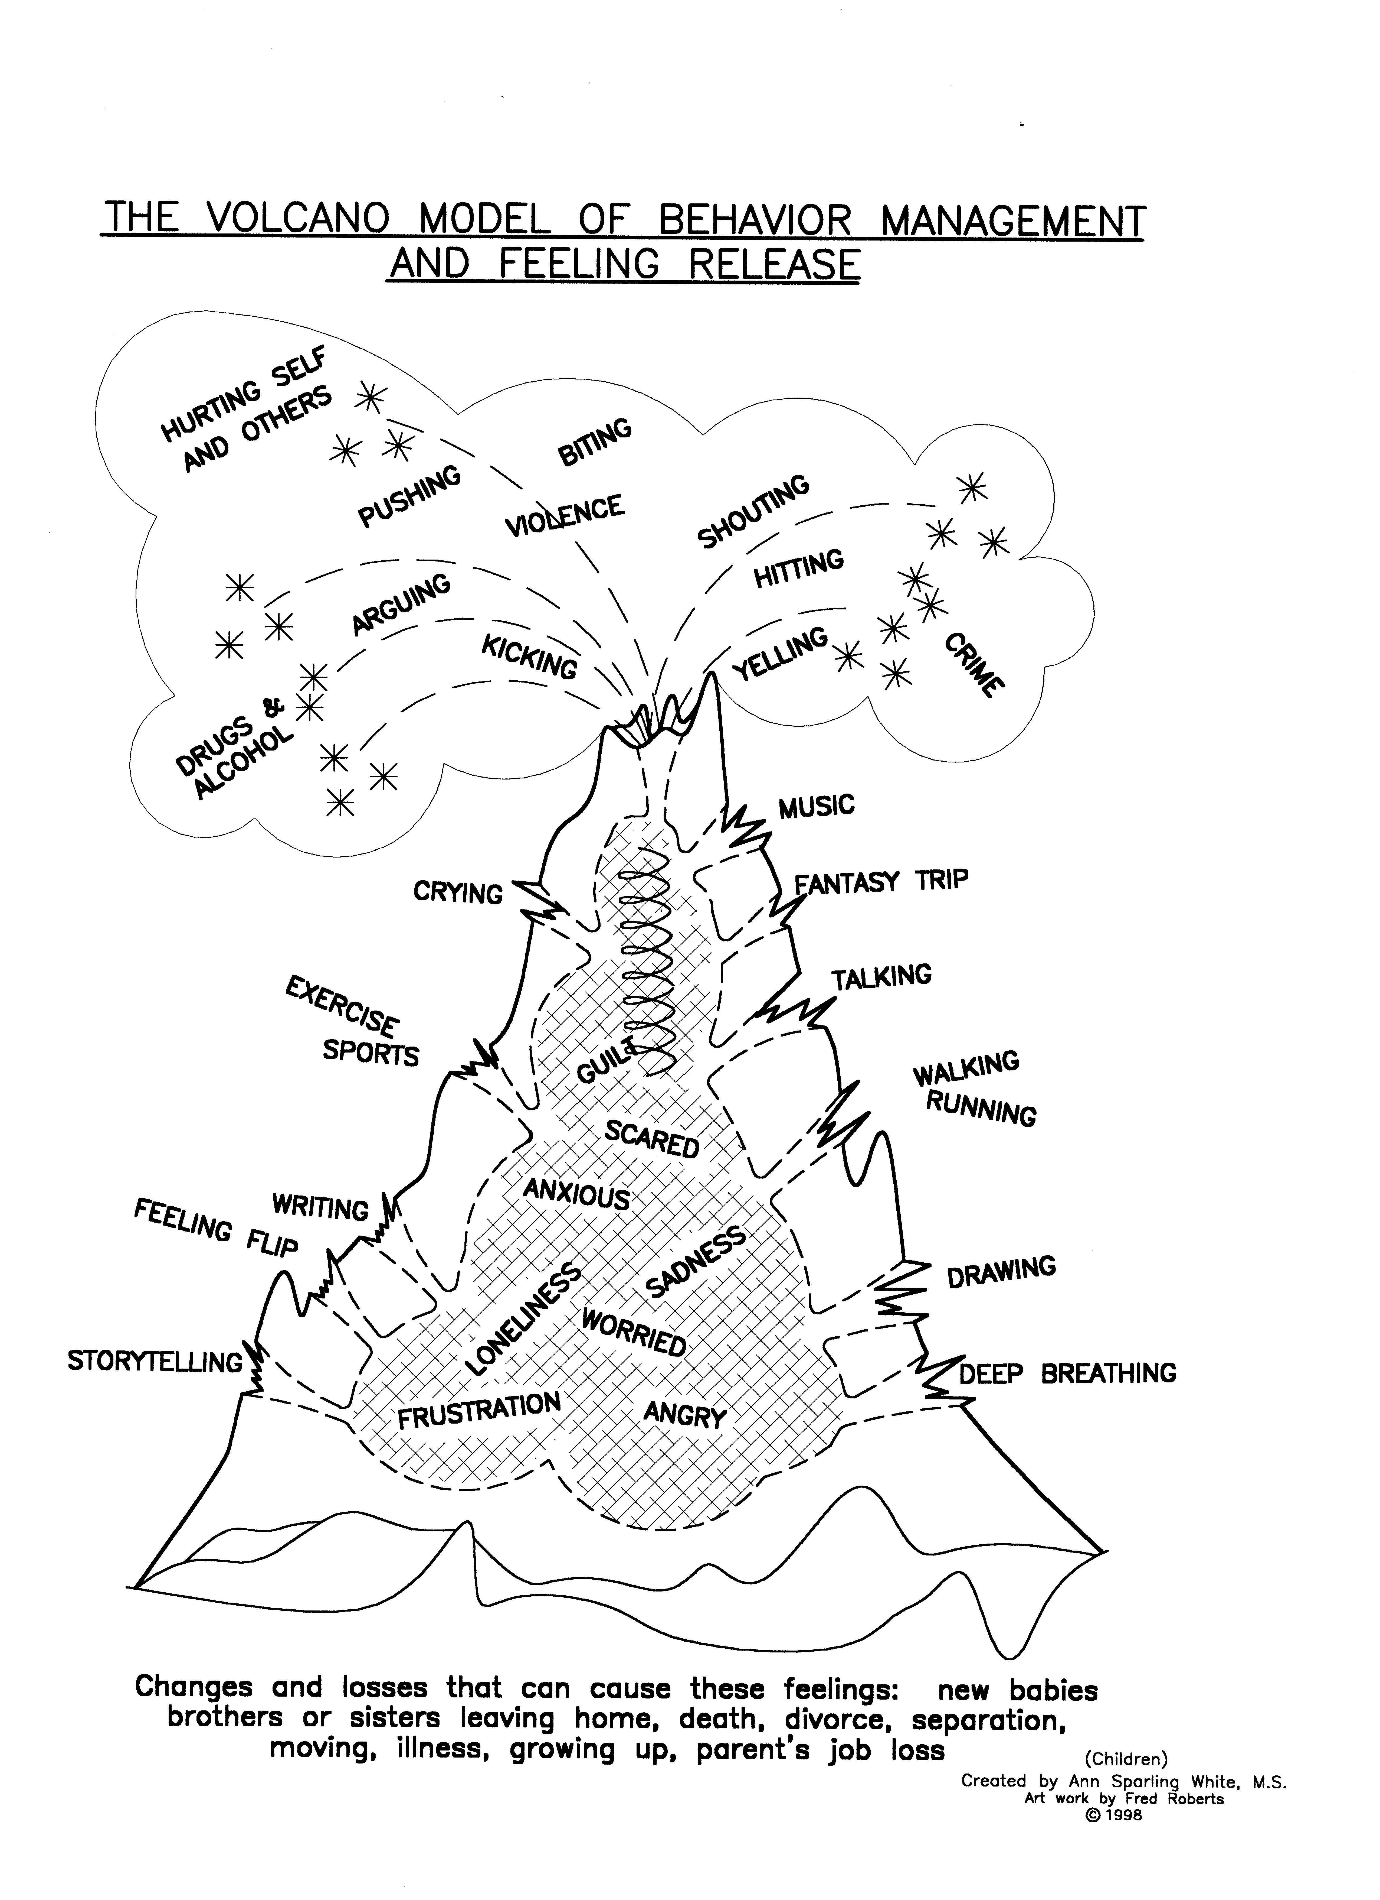
EXPLOSIONS:
Someone always gets hurt
WRECKING THINGS
VENTS:
Always about feelings.
No one gets mad or hurt.
RESTS:
Ways to take a break from feelings

Slide 2
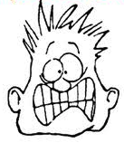
Responses to Stressful Situations and Positive Coping

Slide 3
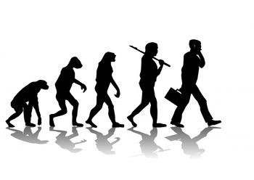
Stress
“The Stress system is a complex, sophisticated, and carefully regulated adaptation that has been shaped by natural selection because it gives a selective advantage.”
Notes:
Emphasize that stress is functional, and that the same stress response in businessmen was in hunters and gatherers. Stress response is the same but stressors are different.

Slide 4
Components The Stress Response
Autonomic Nervous System: Action within the central nervous system that is “reflexive.”
Sympathetic Nervous System
Parasympathetic Nervous System
Notes:
Such as the stress response.

Slide 5
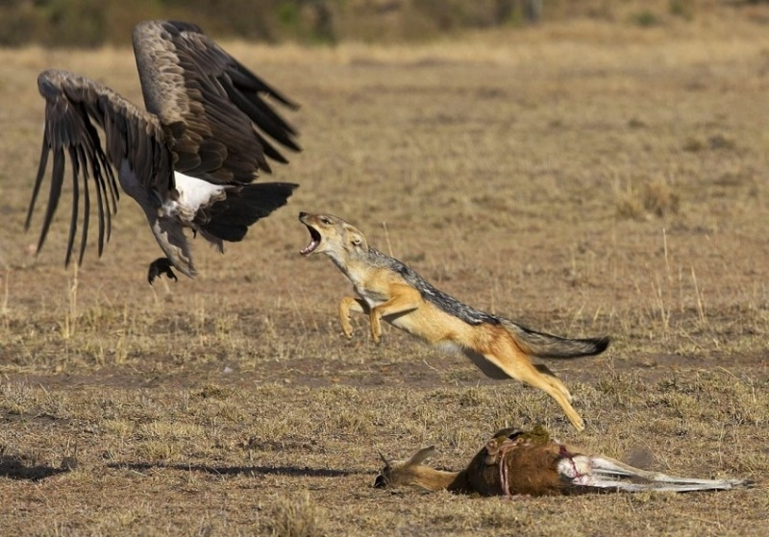
Fight or Flight =
ALARM Stage
The Sympathetic Nervous System takes an active role in triggering the stress response.
The Sympathetic Nervous System effects include increased:
arousal
blood pressure
heart rate
respiratory rate
physical activity
Notes:
For more effects, see Appendix 1 on the Lesson Plan.

Slide 6
Resistance Stage
Acts as an equalizer
Brings body functions back to stability
Notes:
Needs to be a healthy balance between sympathetic and parasympathetic. These 2 systems are constantly active, thus constantly trying to maintain balance.
http://www.google.com/imgres?q=balance&num=10&um=1&hl=en&biw=1920&bih=950&tbm=isch&tbnid=uOr_BMGMwPZHlM:&imgrefurl=http://www.crystalvaults.com/pages/crystal_harmony.php&docid=CNXY7ZEZW1AbcM&imgurl=http://www.crystalvaults.com/images/balance_yinyang_symbol.gif&w=352&h=341&ei=t6a6TvHfIIjg2AW735j-Bg&zoom=1&iact=hc&vpx=542&vpy=317&dur=560&hovh=221&hovw=228&tx=117&ty=109&sig=106962588013688018438&sqi=2&page=1&tbnh=132&tbnw=136&start=0&ndsp=51&ved=1t:429,r:12,s:0

Slide 7
Exhaustion Stage
Energy is depleted
Body returns to normal if stress is removed
Body returns to alarm stage if stress continues which can result in stress-related diseases:
Skin disorders
Gastrointestinal upset
Menstrual irregularities
Cardiovascular disorders

Slide 8
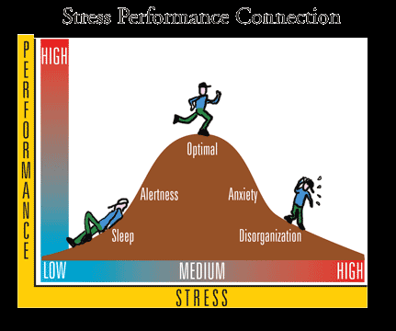
Healthy Amounts of Stress
Stress acts as a motivator, but too much stress can lead to mental illness such as anxiety or depression.
Notes:
Stress is designed to optimize performance.

Slide 9
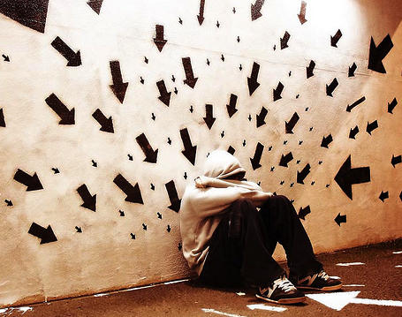
Stress-Related Diseases & Conditions
Gastrointestinal disorders
Skin Disorders
Cancer
Cardiovascular disorders
Depression
Anxiety

Slide 10
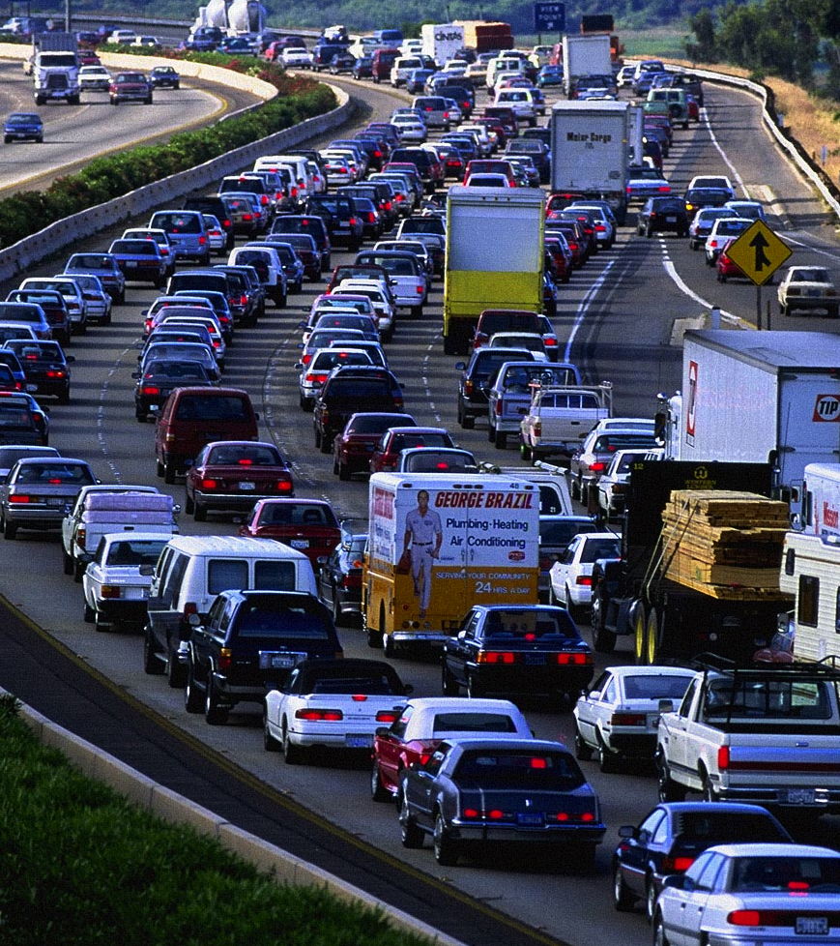
Stressors in the Modern World?
Unemployment
Financial difficulties
Traffic
Social frustrations
Deadlines: homework,
career, taxes, bills
Notes:
All of which do not threaten ones life. These stressors are derrived from the humans ambition to be successful in our modern society. It is important to not that these are stressors that have the potential to be continuous and engrained in our daily life. So even though these stressors seem petty and miniscule, it is important to note that they have the potential to be long term stressors….resulting in anxiety/depression etc.

Slide 11
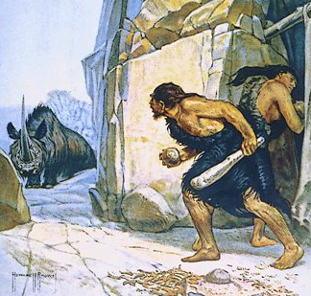
Stressors before Modern Civilization
Need for food
Need for water
Need for shelter
Successfully hunting and gathering
Surviving constant threats in life
Notes:
All of which are functional and have to do with survival

Slide 12
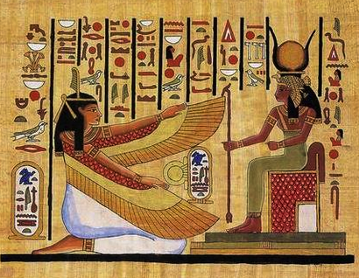
Stress Management in Ancient Civilizations
Worship (spirituality/religion)
Hieroglyphics
Constellations
FINDING MEANING IN LIFE
Notes:
All designed to add meaning to life

Slide 13
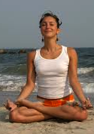
Stress Management Today
Eat
Exercise
Hurt self
Prayer and meditation
Rx medications
Smoking/ drinking/ drugs
Talking to friends and family
Television, reading, or listening to music
Notes:
As the class to examine which stress management tools are healthy, unhealthy, or could be either one.

